Slide 1


Online news popularity prediction
CS – 513 B Knowledge discovery & data mining
Final project
Jainam Shah
Kshiti Rana
Siddharth Gandhi
Prof Khasha Dehnad

Slide 2



Presenters
Jainam Shah | Kshiti Rana | Siddharth Gandhi

Slide 3
Topics covered
Introduction
Dataset Description
Outlier Analysis
Correlation Analysis
Different models for evaluation
Naïve Bayes
Random forest
CART
C5.0
Support Vector Machine
Model Comparison
Conclusion

Slide 4
Introduction
Here we are using dataset on online news popularity to predict whether the news is popular among the readers or not by predicting the shares on the social media..
Dataset is about the articles published by Mashable
https://archive.ics.uci.edu/ml/datasets/Online+News+Popularity
Dataset was taken from UCI repository. It is also available on Kaggle(Invite only).
Dataset summarizes set of features about news articles like Topic, number of unique words, number of stop words etc.

Slide 5
Dataset Description
Dataset contains information about 39644 news articles.
Our goal is to predict whether the article is popular or not based on number of shares.
If number of shares is higher than median value than we categorize it as popular else not popular.

Slide 6
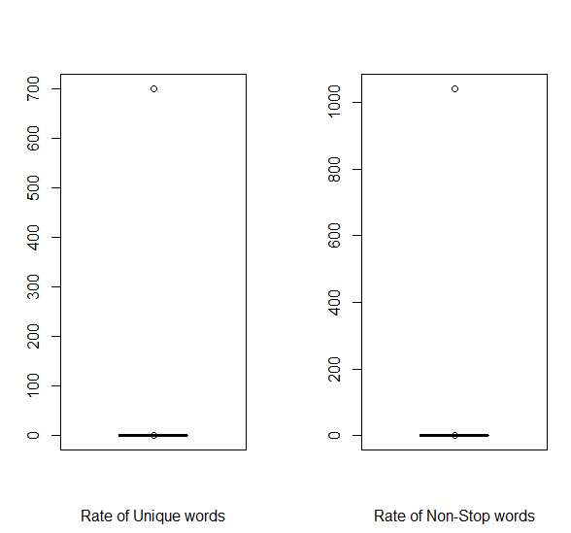
Outlier analysis
Dataset doesn’t have any missing values. So we checked for outliers.
Rate of Unique words and Rate of non-stop Words have outliers
Removed outliers since they are in one observation

Slide 7
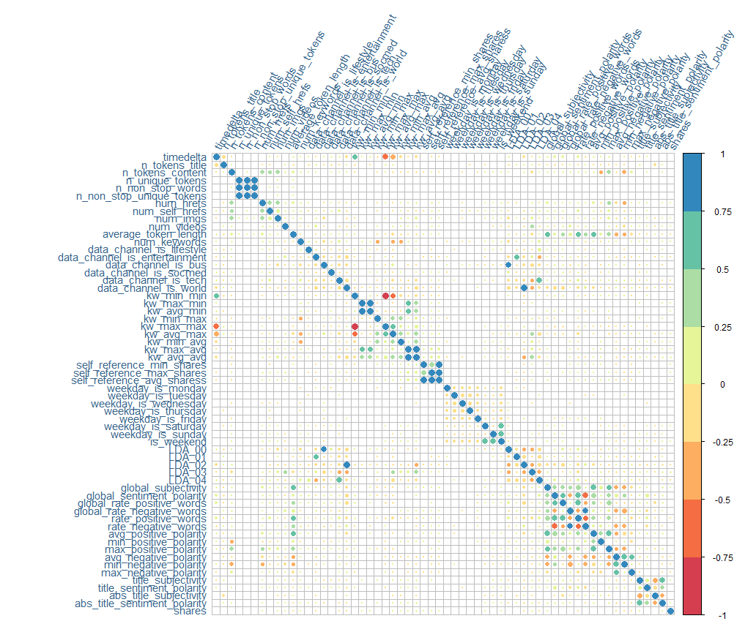
Correlation between attributes
Correlation plot shows which column has how much impact on target variable.
Column which are (Highly Impacted)related to shares are:
KW_avg_avg
LDA_02
Kw_max_avg

Slide 8
Different models for evaluation
Naïve Bayes
Random Forest
CART
C5.0
Support Vector Machine

Slide 9


Naïve Bayes
Works on Probabilistic Classifier
Uses Bayes theorem to classify the data
Confusion Matrix
Error Rate

Slide 10
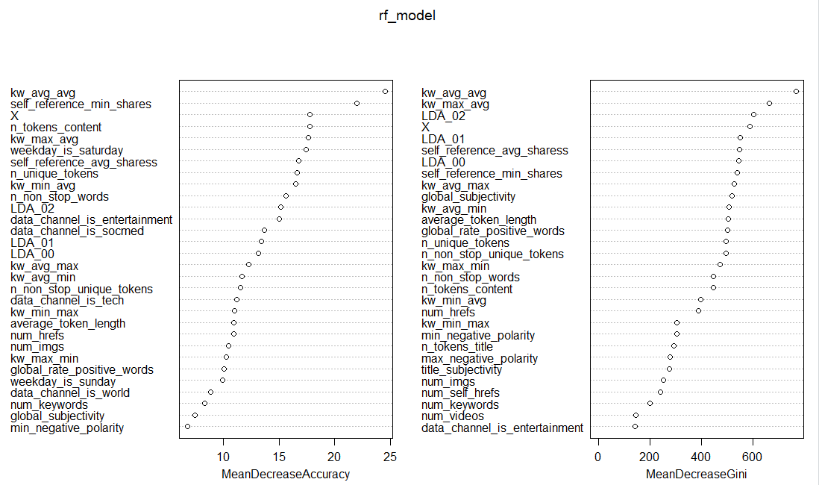
Random Forest
Multiple Decision Trees
Variable Importance plot shows MeanDecreaseAccuracy and MeanDecreaseGini.
MeanDecreaseGini is a coefficient is a measure of how each variable contributes to the homoginity of the nodes and leaves in the resulting random forest.

Slide 11


Random Forest
Confusion Matrix
Error Rate

Slide 12
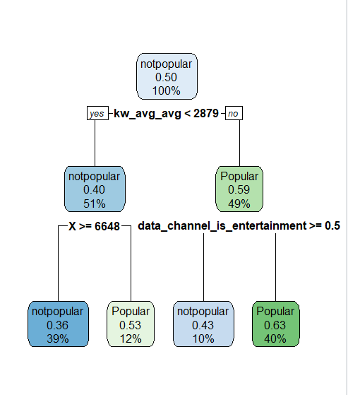
CART
Decision Tree
Generate binary Tree
Used to generate visualized decision rules
for predicting categorical values.

Slide 13
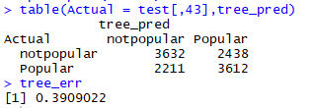
CART
Model confusion matrix and error rate
Better than Naïve Bayes but Random Forest is so far has less error rate.

Slide 14
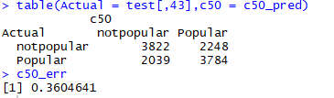
C5.0
Advanced version of CART
Can generate tree with multiple nodes.
Confusion Matrix and error rate

Slide 15
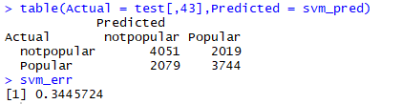
Support Vector Machine
Supervised learning model
Non probabilistic binary classifier
Confusion Matrix and error rate

Slide 16
Model Comparison

Slide 17
Conclusion
Random forest is best to predict news category based on our analysis and SVM is second best model.
Popularity is also depends on topic of article.
News popularity depends on multiple factors:
Day of publication : Weekday or Weekend
Category of news: World or Local

Slide 18

Thank you

